Slide 1
Healthcare Ticket Classification Based on Conversational Data
Submitted by
Venkatasubramanian Thiagarajan
Gadde Rohit Sai Kiran
Raghuveer Chavali
Cute CSE 7312c Group 13

Slide 2
Problem Statement
In this particular case study, the data provided will be analyzed to build a model that will predict whether a conversational record/ ticket can be classified into
Prescription
Appointments
Miscellaneous
Ask_A_Doctor
Lab
Junk
categories based on the predictors of the data set.

Slide 3
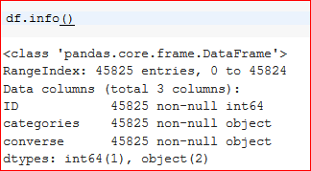
Data Description
ID – Sequential Identifier of Ticket
Categories – Ticket Assignment Groups
Converse – Attribute providing brief description of the call.

Slide 4
Analyzing Missing Data & Excluding Attributes

Slide 5
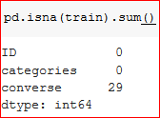
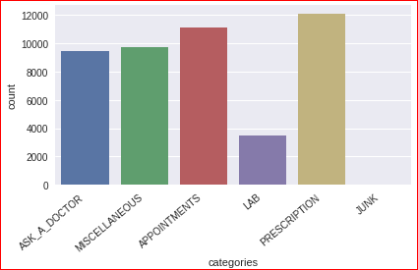
Data Analysis
a) We will not be modifying the variable names for the sake of Brevity.
b) Upon analysis, we can observe that other than “ID”, all of the remaining variables are textual in nature & hence, we will not be factorizing them.
c) The dataset has 45825 observations and 3 variables
d) There are 29 NA Values in the data set
e) We will be converting the “categories” Attribute as a Categorical Column

Slide 6
Data Exploration

Slide 7
Text Normalization Operations
Since, all the data to be processed for classification is conversational text, we will use the following standard Text Normalization Operations-
a) Remove punctuation
b) Convert words to lower case
c) Remove stop words
d) Text Scrubbing
e) Lemmatization
f) Stemming
g) Tokenization

Slide 8
Approach for Classifying the Data

Slide 9
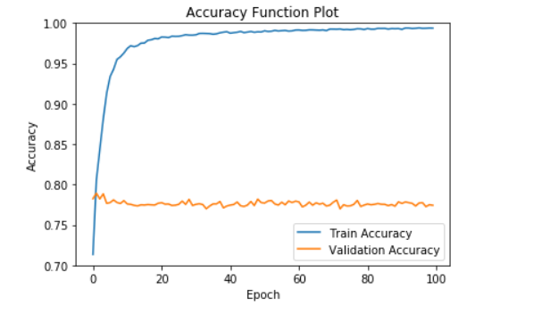
MLP model
Grader:77.93%
Hidden Layer:3

Slide 10
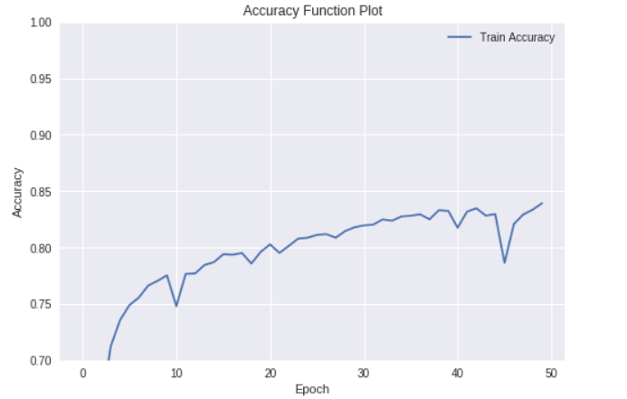
LSTM(cudnn)
Grader:65.4%
Dense Layer:1
LSTM Layer:1

Slide 11
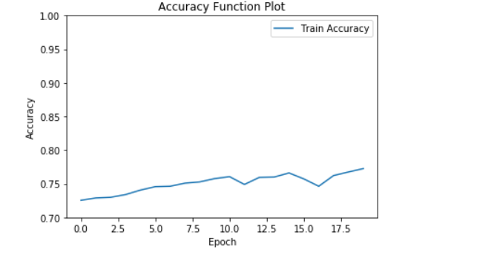
CNN model
Grader:35%
Conv1D:3
MaxPooling1D:2
GlobalMaxPooling1D=1
Dense:1

Slide 12
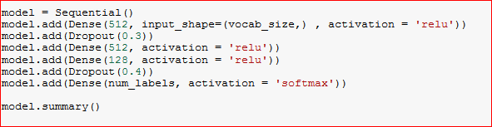
Approach for Classifying the Data
For this we will use the MLP Network Approach to build a Data Model that will predict the probability of classifying a Ticket Description to a Ticketing Category.

Slide 13
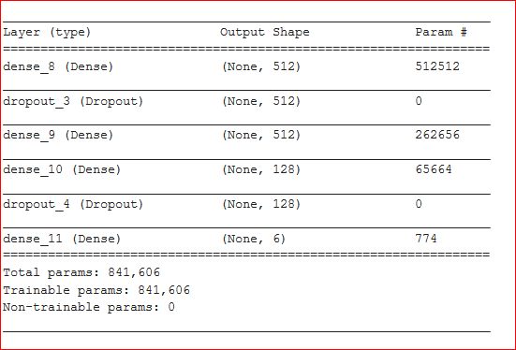

Slide 14
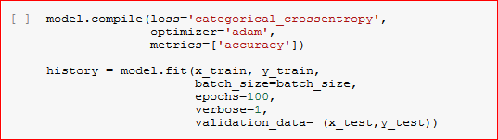
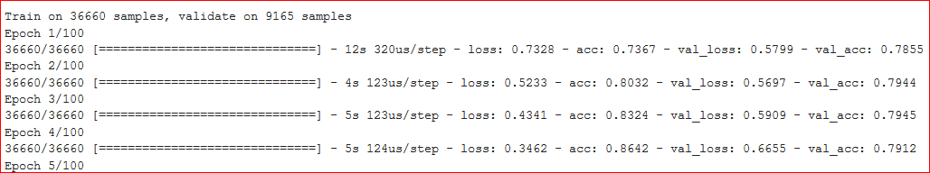
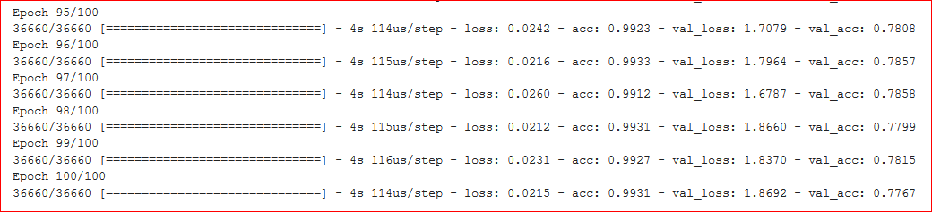

Slide 15
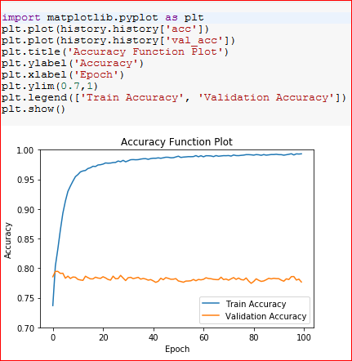
Accuracy Function Plot

Slide 16
Executive Summary
In pattern recognition, information retrieval and classification, precision (also called positive predictive value) is the fraction of relevant instances among the retrieved instances, while recall (also known as sensitivity) is the fraction of relevant instances that have been retrieved over the total amount of relevant instances. Both precision and recall are therefore based on an understanding and measure of relevance.
The Accuracy is 77.93% and hence, the MLP Network Model is able to classify a given call/ ticket description to the appropriate category accurately, ~78 times for every 100 tickets.

